Slide 1
Business Vision - A System Overview [Aromy]
Aromy - Team OneTen

Slide 2
Introduction
Brief Overview of the company
Personas
Business Requirements
High Level Timeline
Development Approach
Conclusion

Slide 3
Brief Overview of the company
Aromy supplies aroma based therapy products and services for the aged care industry.
Limited website functionality
Manual inventory tracking system
Looking to expand and implement new inventory management systems

Slide 4


Personas
Hadywn Fran - 34 years old
Customer: Massage Therapist
Trying to find a new supplier for his business
No tolerance for poor UI website
Particular about brands
Silas Peppercorn - 52 years old
Staff: Warehouse Manager for Aromy
Needs to learn the new system as quickly as possible
Computer literate but under time to learn a new system may be disruptive to current workflow.

Slide 5
Business Requirements
Priority 1
Ability to organise the Inventory on real time
Manage stock flow
Stock arrival from supplier
Updating stock quantity (renewing stock)
Redline/Reorder system
Updating stock quantity (deducting stock)
Ability to organise purchase orders
Manage order flow
Allocating stock to purchases
Dispatching stock
Sending information (emails) to customer orders
Order confirmation
Invoice
Order status (includes the shipping details)

Slide 6
Business Requirements
Priority 2
Product information
Editing (images, product prices, product information)
Adding (new product)
Deleting
Customer account
Login/Logout
Purchase History
Shopping cart
Customer profile

Slide 7
Business Requirements
Priority 3 :
Rewards/ credit points for purchases

Slide 8
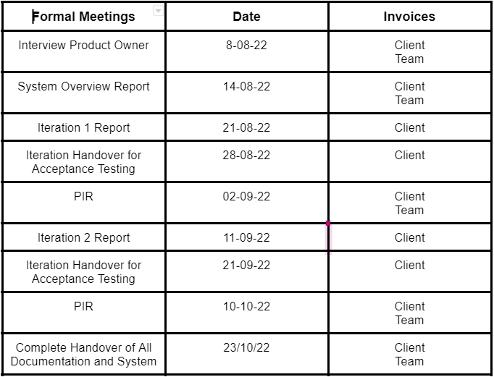
High Level Timeline

Slide 9
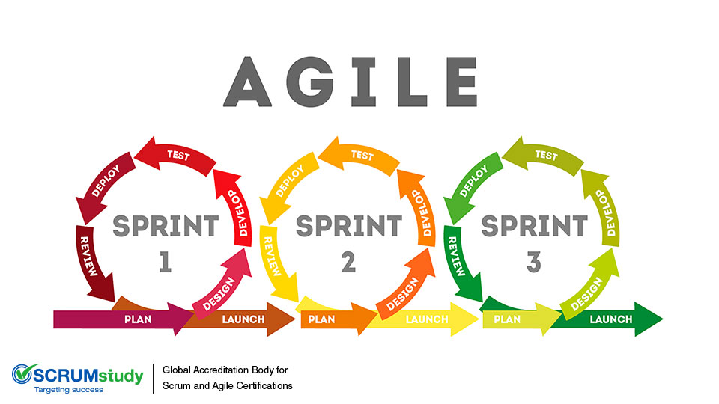
System Development Approach
The team will conduct the project using Agile framework
2 iterations will be performed
Indicate changes at any time
Modify the priorities on business requirements
Involvement throughout the project
View the complete part of an iteration
Notes:
Blending-Agile-Frameworks-for-Project-Success.jpg

Slide 10
Conclusion
Inventory System changes
Build a new online system and bolster Aromy’s customer base
Seek business developments as a result of systemic improvements
Notes:
The end product will include the inventory system and retail platform based on the business requirements from Aromy.
Overall, the handover will be delivered once the product is accepted by the client.
Thank you for listening to our presentation.

